Slide 1

Introduction to Probabilistic Machine Learning
Ralf Herbrich, Jakob Walter
Information & Inference

Slide 2
Overview
Information Theory
Arithmetic Coding
Distance Measures for Probabilities
Inference Methods
Bayesian Inference
Maximum Likelihood Estimation
Decision Making

Slide 3
Overview
Information Theory
Arithmetic Coding
Distance Measures for Probabilities
Inference Methods
Bayesian Inference
Maximum Likelihood Estimation
Decision Making

Slide 4
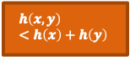


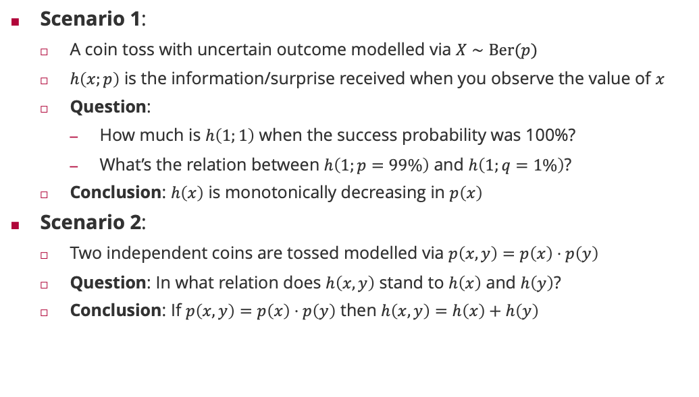



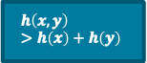

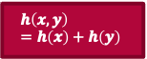
Motivating Example: Information and Coin Tosses
$$h\left(x,y\right) =h\left(x\right)+h\left(y\right)$$
$$h\left(x,y\right) >h\left(x\right)+h\left(y\right)$$
Scenario 1:
A coin toss with uncertain outcome modelled via $X∼Ber(p)$
$h\left(x;p\right)$ is the information/surprise received when you observe the value of $x$
Question:
How much is $h\left(1;1\right)$ when the success probability was 100%?
What’s the relation between $h\left(1;p=99\%\right)$ and $h\left(1;q=1\%\right)$?
Conclusion: $h\left(x\right)$ is monotonically decreasing in $p\left(x\right)$
Scenario 2:
Two independent coins are tossed modelled via $p\left(x,y\right)=p\left(x\right)⋅p\left(y\right)$
Question: In what relation does $h\left(x,y\right)$ stand to $h\left(x\right)$ and $h\left(y\right)$?
Conclusion: If $p\left(x,y\right)=p\left(x\right)⋅p\left(y\right)$ then $h\left(x,y\right)=h\left(x\right)+h\left(y\right)$
$$h\left(1;p\right)>h\left(1;q\right)$$
$$h(1;1) = 0$$
$$h\left(1;p\right)<h\left(1;q\right)$$
$$h\left(1;1\right)> 0$$
$$h\left(x,y\right) <h\left(x\right)+h\left(y\right)$$
$$h\left(1;p\right)=h\left(1;q\right)$$
$$h\left(x\right)=−\log_{b}\left(p\left(x\right)\right)⁡$$

Slide 5
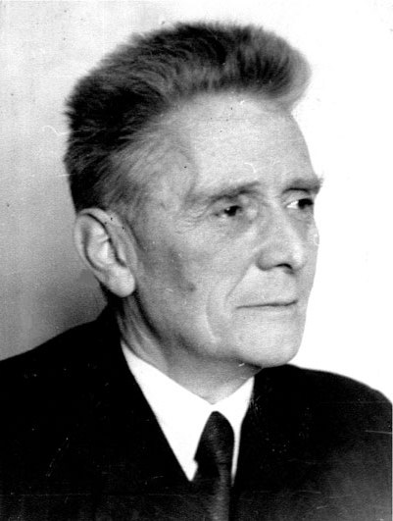
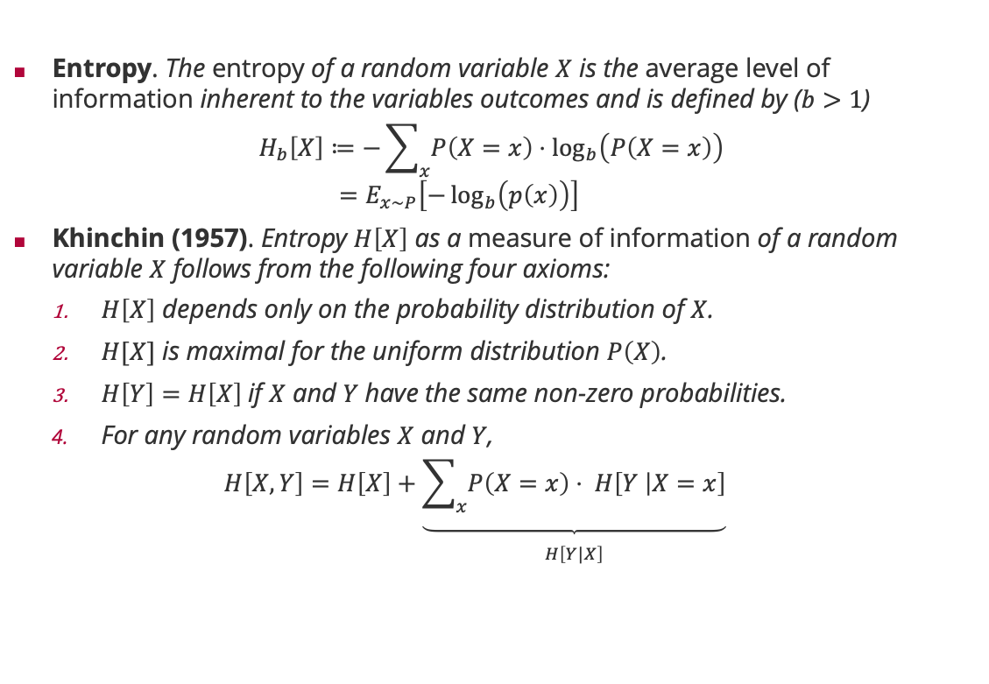
Measure of Information: Entropy
Entropy. The entropy of a random variable $X$ is the average level of information inherent to the variables outcomes and is defined by ($b>1$)
$$H_{b}\left[X\right]≔−\sum_{x}{P\left(X=x\right)⋅\log_{b}\left(P\left(X=x\right)\right) } \\ =E_{x∼P}\left[−\log_{b}\left(p\left(x\right)\right)\right]$$
Khinchin (1957). Entropy $H\left[X\right]$ as a measure of information of a random variable $X$ follows from the following four axioms:
$H\left[X\right]$ depends only on the probability distribution of $X$.
$H[X]$ is maximal for the uniform distribution $P\left(X\right)$.
$H\left[Y\right]=H\left[X\right]$if $X$ and $Y$have the same non-zero probabilities.
For any random variables $X$ and $Y$,
$$H\left[X, Y\right]=H\left[X\right]+\underset{\begin{aligned} \\ H\left[Y|X\right]\end{aligned}}{\underbrace{\sum_{x}{P\left(X=x\right)⋅ H\left[Y | X=x\right]}}}$$
Aleksandr Khinchin (1894 – 1959)

Slide 6
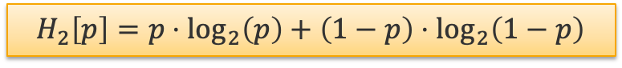
Example: Binary Entropy
$$H_{2}\left[p\right]=p⋅\log_{2}\left(p\right)+\left(1−p\right)⋅\log_{2}\left(1−p\right)$$

Slide 7

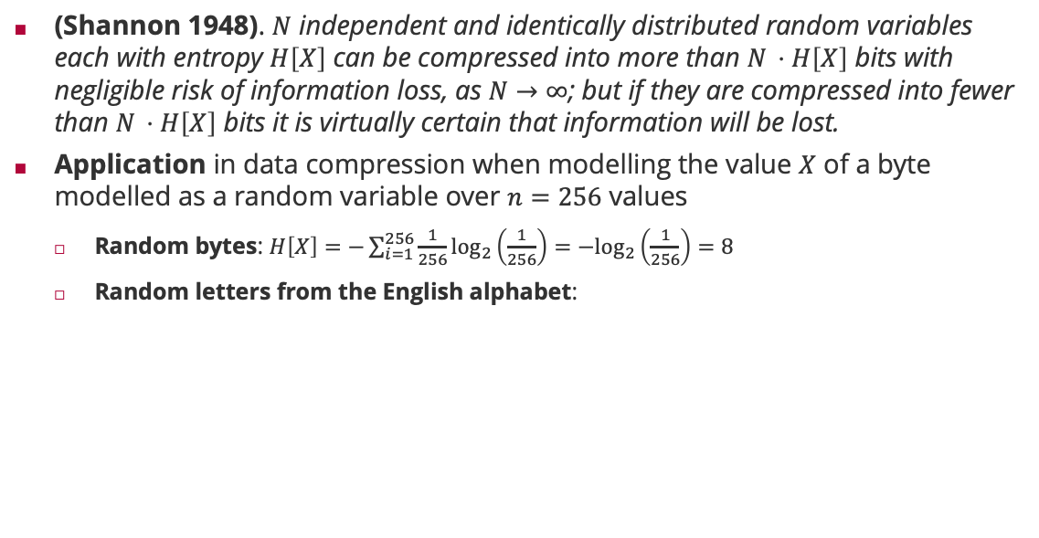

Entropy and the Noiseless Coding Theorem
(Shannon 1948). $N$ independent and identically distributed random variables each with entropy $H\left[X\right]$ can be compressed into more than $N ⋅H\left[X\right]$ bits with negligible risk of information loss, as $N→∞$; but if they are compressed into fewer than $N ⋅H\left[X\right]$ bits it is virtually certain that information will be lost.
Application in data compression when modelling the value $X$ of a byte modelled as a random variable over $n=256$ values
Random bytes: $H\left[X\right]=−\sum_{i=1}^{256}{\frac{1}{256}\log_{2}\left(\frac{1}{256}\right)=−\log_{2}\left(\frac{1}{256}\right)=8}$
Random letters from the English alphabet:
Claude Shannon (1913 – 2001)
$$H = 4.48917$$

Slide 8
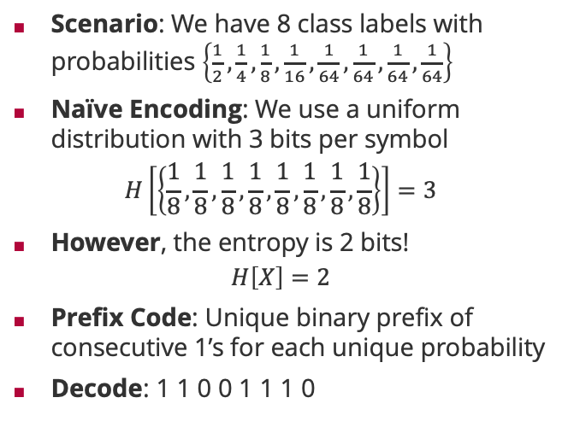
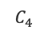
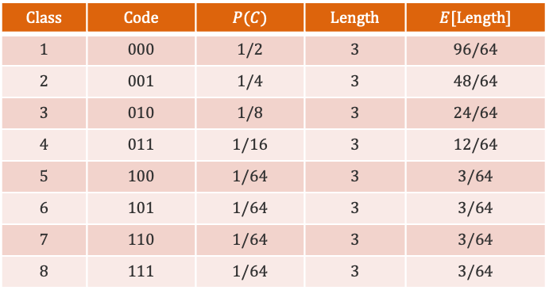
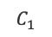
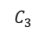
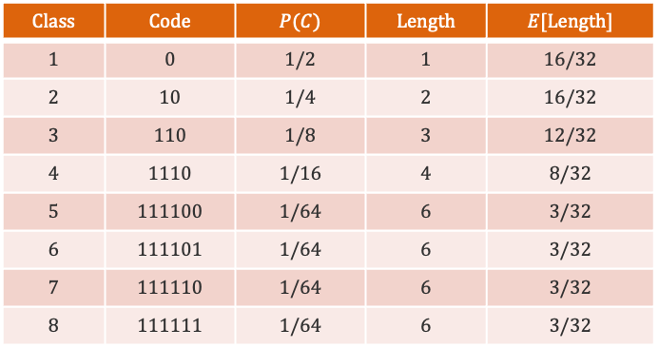
Noiseless Coding Theorem: An Example
Scenario: We have 8 class labels with probabilities $\left\{\frac{1}{2},\frac{1}{4},\frac{1}{8},\frac{1}{16},\frac{1}{64},\frac{1}{64},\frac{1}{64},\frac{1}{64}\right\}$
Naïve Encoding: We use a uniform distribution with 3 bits per symbol
$$H\left[\left\{\frac{1}{8},\frac{1}{8},\frac{1}{8},\frac{1}{8},\frac{1}{8},\frac{1}{8},\frac{1}{8},\frac{1}{8}\right\}\right]=3$$
However, the entropy is 2 bits!
$$H\left[X\right]=2$$
Prefix Code: Unique binary prefix of consecutive 1’s for each unique probability
Decode: 1 1 0 0 1 1 1 0
$$Class$$ | $$Code$$ | $$P(C)$$ | $$Length$$ | $$E[Length]$$
$$1$$ | $$0$$ | $$1/2$$ | $$1$$ | $$16/32$$
$$2$$ | $$10$$ | $$1/4$$ | $$2$$ | $$16/32$$
$$3$$ | $$110$$ | $$1/8$$ | $$3$$ | $$12/32$$
$$4$$ | $$1110$$ | $$1/16$$ | $$4$$ | $$8/32$$
$$5$$ | $$111100$$ | $$1/64$$ | $$6$$ | $$3/32$$
$$6$$ | $$111101$$ | $$1/64$$ | $$6$$ | $$3/32$$
$$7$$ | $$111110$$ | $$1/64$$ | $$6$$ | $$3/32$$
$$8$$ | $$111111$$ | $$1/64$$ | $$6$$ | $$3/32$$
$$Class$$ | $$Code$$ | $$P(C)$$ | $$Length$$ | $$E[Length]$$
$$1$$ | $$000$$ | $$1/2$$ | $$3$$ | $$96/64$$
$$2$$ | $$001$$ | $$1/4$$ | $$3$$ | $$48/64$$
$$3$$ | $$010$$ | $$1/8$$ | $$3$$ | $$24/64$$
$$4$$ | $$011$$ | $$1/16$$ | $$3$$ | $$12/64$$
$$5$$ | $$100$$ | $$1/64$$ | $$3$$ | $$3/64$$
$$6$$ | $$101$$ | $$1/64$$ | $$3$$ | $$3/64$$
$$7$$ | $$110$$ | $$1/64$$ | $$3$$ | $$3/64$$
$$8$$ | $$111$$ | $$1/64$$ | $$3$$ | $$3/64$$
$$C_{3}$$
$$C_{1}$$
$$C_{4}$$

Slide 9
Overview
Information Theory
Arithmetic Coding
Distance Measures for Probabilities
Inference Methods
Bayesian Inference
Maximum Likelihood Estimation
Decision Making

Slide 10

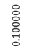
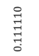
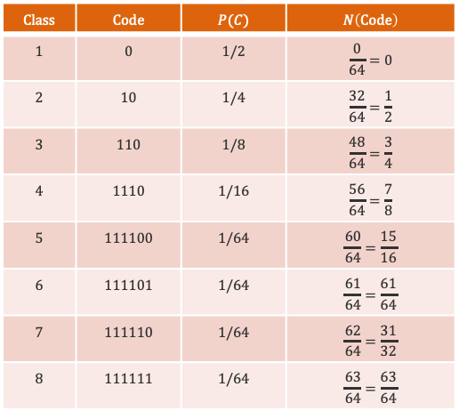

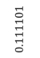
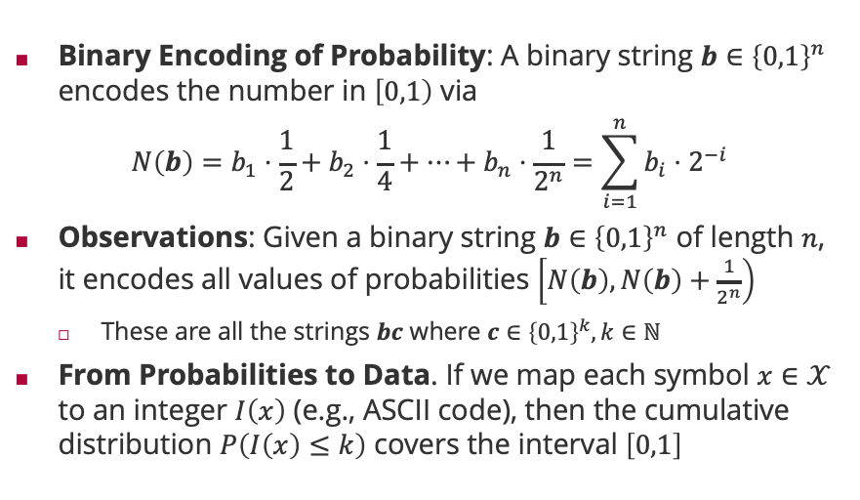
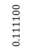
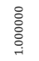

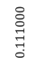
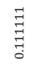

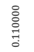
Arithmetic Coding
Binary Encoding of Probability: A binary string $b∈{\left\{0,1\right\}}^{n}$ encodes the number in $\left[0,1\right)$ via
$$N\left(b\right)=b_{1}⋅\frac{1}{2}+b_{2}⋅\frac{1}{4}+⋯+b_{n}⋅\frac{1}{2^{n}}=\sum_{i=1}^{n}{{b_{i}⋅2}^{−i}}$$
Observations: Given a binary string $b∈{\left\{0,1\right\}}^{n}$ of length $n$, it encodes all values of probabilities $\left[N\left(b\right),N\left(b\right)+\frac{1}{2^{n}}\right)$
These are all the strings $bc$ where $c∈{\left\{0,1\right\}}^{k}, k∈ℕ$
From Probabilities to Data. If we map each symbol $x∈𝒳$ to an integer $I\left(x\right)$ (e.g., ASCII code), then the cumulative distribution $P\left(I\left(x\right)≤k\right)$ covers the interval $\left[0,1\right]$
$$Class$$ | $$Code$$ | $$P(C)$$ | $$N\left(Code\right)$$
$$1$$ | $$0$$ | $$1/2$$ | $$\frac{0}{64}=0$$
$$2$$ | $$10$$ | $$1/4$$ | $$\frac{32}{64}=\frac{1}{2}$$
$$3$$ | $$110$$ | $$1/8$$ | $$\frac{48}{64}=\frac{3}{4}$$
$$4$$ | $$1110$$ | $$1/16$$ | $$\frac{56}{64}=\frac{7}{8}$$
$$5$$ | $$111100$$ | $$1/64$$ | $$\frac{60}{64}=\frac{15}{16}$$
$$6$$ | $$111101$$ | $$1/64$$ | $$\frac{61}{64}=\frac{61}{64}$$
$$7$$ | $$111110$$ | $$1/64$$ | $$\frac{62}{64}=\frac{31}{32}$$
$$8$$ | $$111111$$ | $$1/64$$ | $$\frac{63}{64}=\frac{63}{64}$$
$$C_{1}$$
$$C_{2}$$
$$C_{3}$$
$$C_{4}$$
$$C_{5}$$
$$C_{6}$$
$$C_{7}$$
$$C_{8}$$
$$1.000000$$
$$0.000000$$
$$0.110000$$
$$0.111000$$
$$0.111101$$
$$0.111111$$
$$0.100000$$
$$0.111100$$
$$0.111110$$

Slide 11
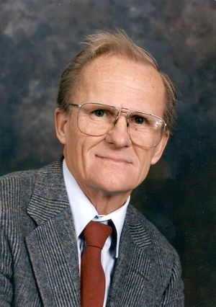
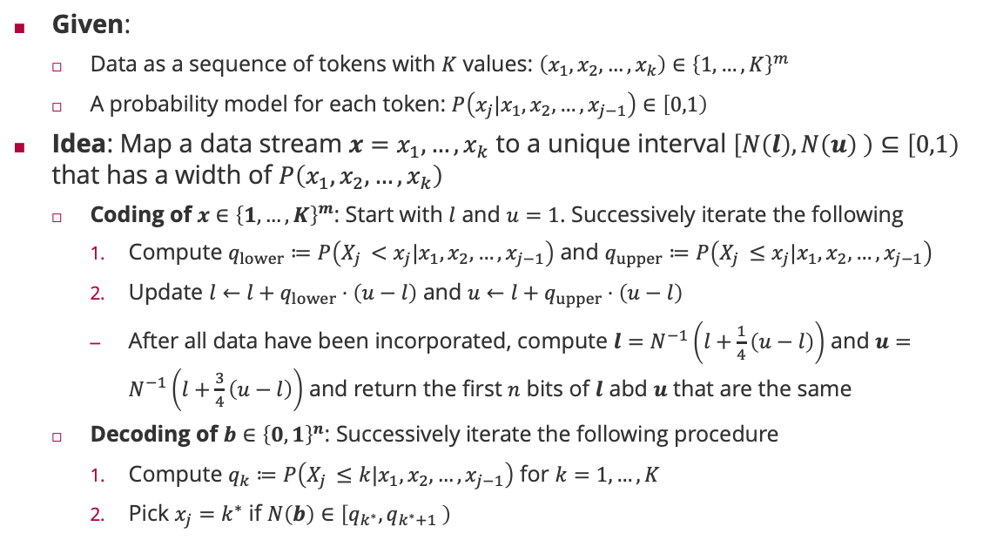
Arithmetic Coding: Algorithm
Given:
Data as a sequence of tokens with $K$ values: $\left(x_{1},x_{2},…,x_{k}\right)∈{\left\{1,…,K\right\}}^{m}$
A probability model for each token: $P\left(x_{j}|x_{1},x_{2},…,x_{j−1}\right)∈\left[0,1\right)$
Idea: Map a data stream $x=x_{1}, …,x_{k}$ to a unique interval $\left[N\left(l\right),N\left(u\right) \right)⊆\left[0,1\right)$ that has a width of $P\left(x_{1},x_{2},…,x_{k}\right)$
Coding of $x∈{\left\{1,…,K\right\}}^{m}$: Start with $l$ and $u=1$. Successively iterate the following
Compute $q_{lower}≔P\left(X_{j }<x_{j}|x_{1},x_{2},…,x_{j−1}\right)$ and $q_{upper}≔P\left(X_{j }≤x_{j}|x_{1},x_{2},…,x_{j−1}\right)$
Update $l←l+q_{lower}⋅\left(u−l\right)$ and $u←l+q_{upper}⋅\left(u−l\right)$
After all data have been incorporated, compute $l=N^{−1}\left(l+\frac{1}{4}\left(u−l\right)\right)$ and $u=N^{−1}\left(l+\frac{3}{4}\left(u−l\right)\right)$ and return the first $n$ bits of $l$ abd $u$ that are the same
Decoding of $b∈{\left\{0,1\right\}}^{n}$: Successively iterate the following procedure
Compute $q_{k}≔P\left(X_{j }≤k|x_{1},x_{2},…,x_{j−1}\right)$ for $k=1,…,K$
Pick $x_{j}=k^{∗}$ if $N\left(b\right)∈\left[q_{k^{∗}},q_{k^{∗}+1} \right)$
Jorma Rissanen (1932 – 2020)

Slide 12
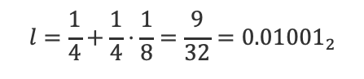
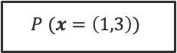
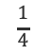
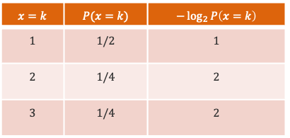
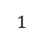
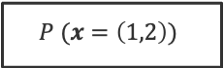



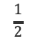
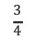
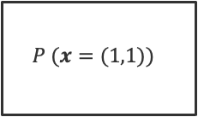
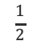
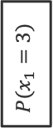

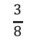
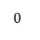
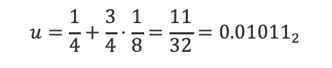
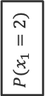
Arithmetic Coding: An Example
$$x=k$$ | $$P(x=k)$$ | $$−\log_{2}{P\left(x=k\right)}$$
$$1$$ | $$1/2$$ | $$1$$
$$2$$ | $$1/4$$ | $$2$$
$$3$$ | $$1/4$$ | $$2$$
$$0$$
$$0$$
$$x=\left(1,2\right)$$
$$P(x_{1}=1)$$
$$P (x=(1,1))$$
$$\frac{1}{4}$$
$$P (x=\left(1,2\right))$$
$$\frac{3}{8}$$
$$b=\left(0,1,0\right)$$
$$P (x=\left(1,3\right))$$
$$\frac{1}{2}$$
$$\frac{1}{2}$$
$$P(x_{1}=2)$$
$$l=\frac{1}{4}+\frac{1}{4}⋅\frac{1}{8}=\frac{9}{32}={0.01001}_{2}$$
$$\frac{3}{4}$$
$$u=\frac{1}{4}+\frac{3}{4}⋅\frac{1}{8}=\frac{11}{32}={0.01011}_{2}$$
$$P(x_{1}=3)$$
$$1$$

Slide 13

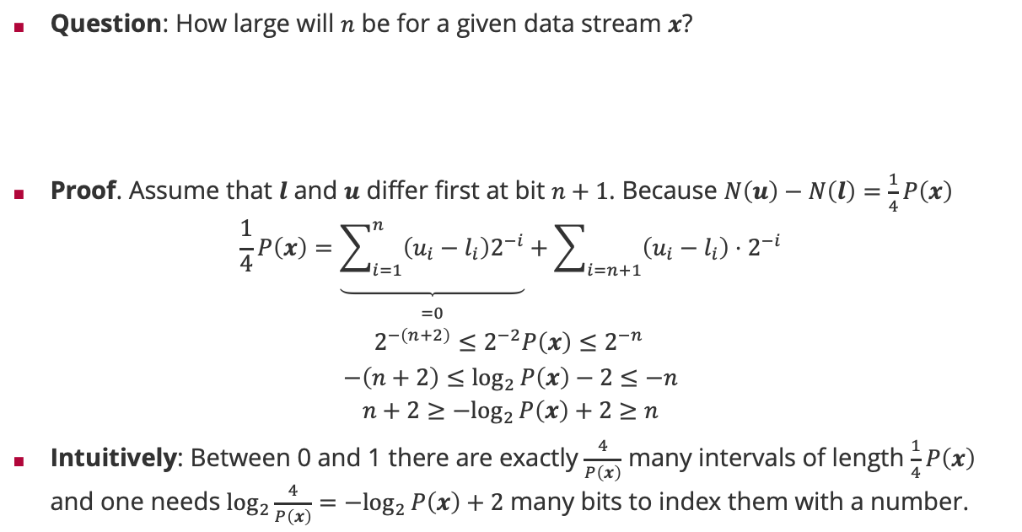
Arithmetic Coding: Optimal Code Length
Question: How large will $n$ be for a given data stream $x$?
Proof. Assume that $l$ and $u$ differ first at bit $n+1$. Because $N\left(u\right)−N\left(l\right)=\frac{1}{4}P\left(x\right)$
$$\frac{1}{4}P\left(x\right)=\underset{\begin{aligned} \\ =0\end{aligned}}{\underbrace{\sum_{i=1}^{n}{\left(u_{i}−l_{i}\right)2^{−i}}}}+\sum_{i=n+1}{\left(u_{i}−l_{i}\right)⋅2^{−i}}$$
$$2^{−\left(n+2\right)}≤2^{−2}P\left(x\right)≤2^{−n }$$
$$−\left(n+2\right)≤\log_{2}{P\left(x\right)−2}≤−n$$
$$n+2≥{−log}_{2}{P\left(x\right)}+2≥n$$
Intuitively: Between 0 and 1 there are exactly $\frac{4}{P\left(x\right)}$ many intervals of length $\frac{1}{4}P\left(x\right)$ and one needs $\log_{2}\frac{4}{P\left(x\right)}={−log}_{2}{P\left(x\right)}+2$ many bits to index them with a number.
$$−\log_{2}{P\left(x\right)}≤n≤−\log_{2}{P\left(x\right)}+2$$

Slide 14
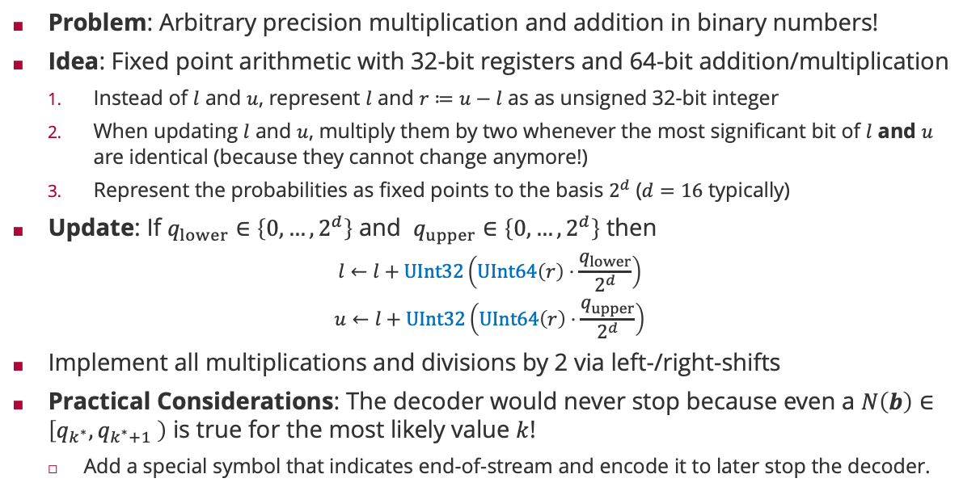
Arithmetic Coding: Fixed Point Arithmetic
Problem: Arbitrary precision multiplication and addition in binary numbers!
Idea: Fixed point arithmetic with 32-bit registers and 64-bit addition/multiplication
Instead of $l$ and $u$, represent $l$ and $r≔u−l$ as as unsigned 32-bit integer
When updating $l$ and $u$, multiply them by two whenever the most significant bit of $l$ and $u$ are identical (because they cannot change anymore!)
Represent the probabilities as fixed points to the basis $2^{d}$ ($d=16$ typically)
Update: If $q_{lower}∈\left\{0,…,2^{d}\right\}$ and $q_{upper}∈\left\{0,…,2^{d}\right\}$ then
$$l←l+UInt32\left(UInt64\left(r\right)⋅\frac{q_{lower}}{2^{d}}\right)$$
$$u←l+UInt32\left(UInt64\left(r\right)⋅\frac{q_{upper}}{2^{d}}\right)$$
Implement all multiplications and divisions by 2 via left-/right-shifts
Practical Considerations: The decoder would never stop because even a $N\left(b\right)∈\left[q_{k^{∗}},q_{k^{∗}+1} \right)$ is true for the most likely value $k$!
Add a special symbol that indicates end-of-stream and encode it to later stop the decoder.

Slide 15
Overview
Information Theory
Arithmetic Coding
Distance Measures for Probabilities
Inference Methods
Bayesian Inference
Maximum Likelihood Estimation
Decision Making

Slide 16

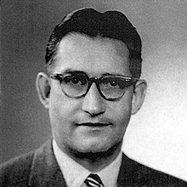
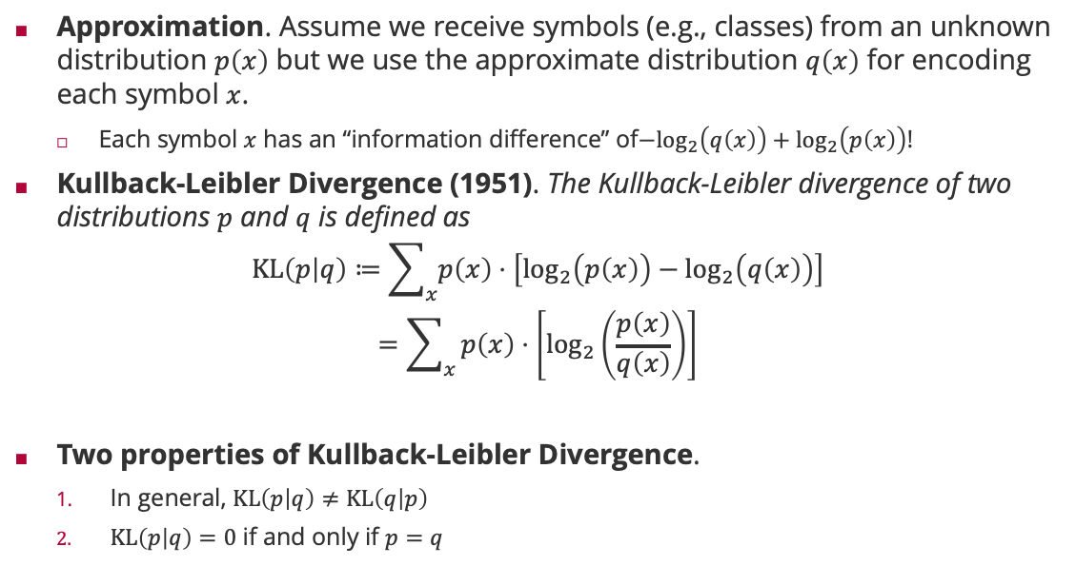
Relative Entropy: Kullback-Leibler Divergence
Approximation. Assume we receive symbols (e.g., classes) from an unknown distribution $p\left(x\right)$ but we use the approximate distribution $q\left(x\right)$ for encoding each symbol $x$.
Each symbol $x$ has an “information difference” of${−log}_{2}\left(q\left(x\right)\right)+\log_{2}\left(p\left(x\right)\right)$!
Kullback-Leibler Divergence (1951). The Kullback-Leibler divergence of two distributions $p$ and $q$ is defined as
$$KL\left(p | q\right)≔\sum_{x}{p\left(x\right)⋅\left[\log_{2}\left(p\left(x\right)\right)−\log_{2}\left(q\left(x\right)\right)\right]}$$
$$=\sum_{x}{p\left(x\right)⋅\left[\log_{2}\left(\frac{p\left(x\right)}{q\left(x\right)}\right)\right]}$$
Two properties of Kullback-Leibler Divergence.
In general, $KL\left(p | q\right)≠KL\left(q | p\right)$
$KL\left(p | q\right)=0$ if and only if $p=q$
Solomon Kullback (1909 – 1994)
Richard Leibler (1914 – 2003)

Slide 17



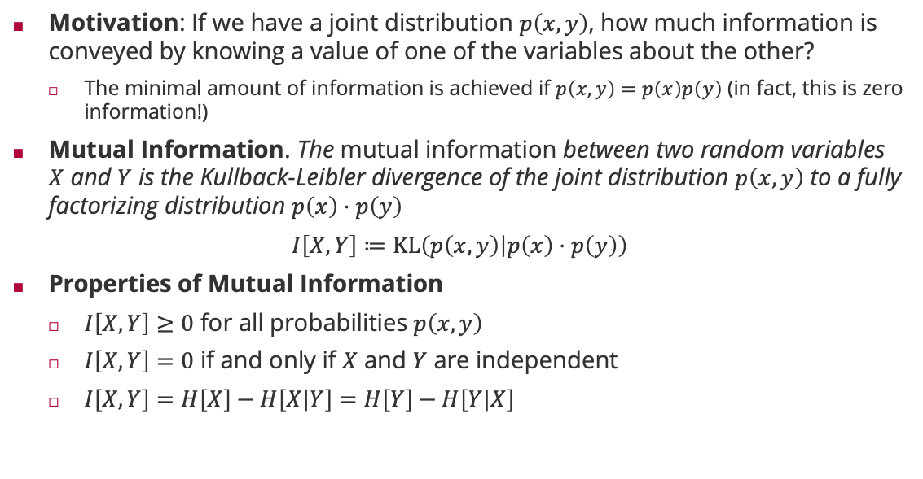



Mutual Information
Motivation: If we have a joint distribution $p\left(x,y\right)$, how much information is conveyed by knowing a value of one of the variables about the other?
The minimal amount of information is achieved if $p\left(x,y\right)=p\left(x\right)p\left(y\right)$ (in fact, this is zero information!)
Mutual Information. The mutual information between two random variables $X$ and $Y$ is the Kullback-Leibler divergence of the joint distribution $p\left(x,y\right)$ to a fully factorizing distribution $p\left(x\right)⋅p\left(y\right)$
$I\left[X,Y\right]≔KL\left(p\left(x,y\right) | p\left(x\right)⋅p\left(y\right)\right)$
Properties of Mutual Information
$I\left[X,Y\right]≥0$ for all probabilities $p\left(x,y\right)$
$I\left[X,Y\right]=0$ if and only if $X$ and $Y$ are independent
$I\left[X,Y\right]=H\left[X\right]−H\left[X | Y\right]=H\left[Y\right]−H\left[Y | X\right]$
$$H[X,Y]$$
$$H[X]$$
$$H[Y]$$
$$H[X|Y]$$
$I[X,Y]$
$$H[Y|X]$$

Slide 18
Overview
Information Theory
Arithmetic Coding
Distance Measures for Probabilities
Inference Methods
Bayesian Inference
Maximum Likelihood Estimation
Decision Making

Slide 19
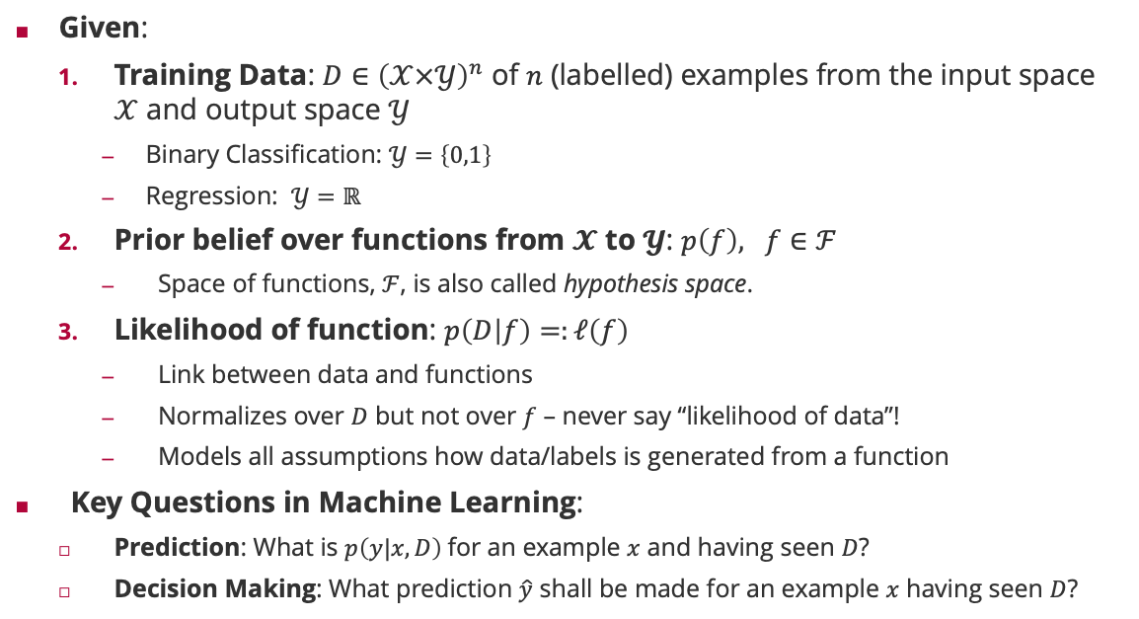
Probabilistic Machine Learning: Terminology
Given:
Training Data: $D∈{\left(𝒳×𝒴\right)}^{n}$ of $n$ (labelled) examples from the input space $𝒳$ and output space $𝒴$
Binary Classification: $𝒴=\left\{0,1\right\}$
Regression: $𝒴=ℝ$
Prior belief over functions from $𝓧$ to $𝓨$: $p\left(f\right), f∈ℱ$
Space of functions, $ℱ$, is also called hypothesis space.
Likelihood of function: $p\left(D | f\right)=:ℓ\left(f\right)$
Link between data and functions
Normalizes over $D$ but not over $f$ – never say “likelihood of data”!
Models all assumptions how data/labels is generated from a function
Key Questions in Machine Learning:
Prediction: What is $p\left(y|x,D\right)$for an example $x$ and having seen $D$?
Decision Making: What prediction $\hat{y}$ shall be made for an example $x$ having seen $D$?

Slide 20
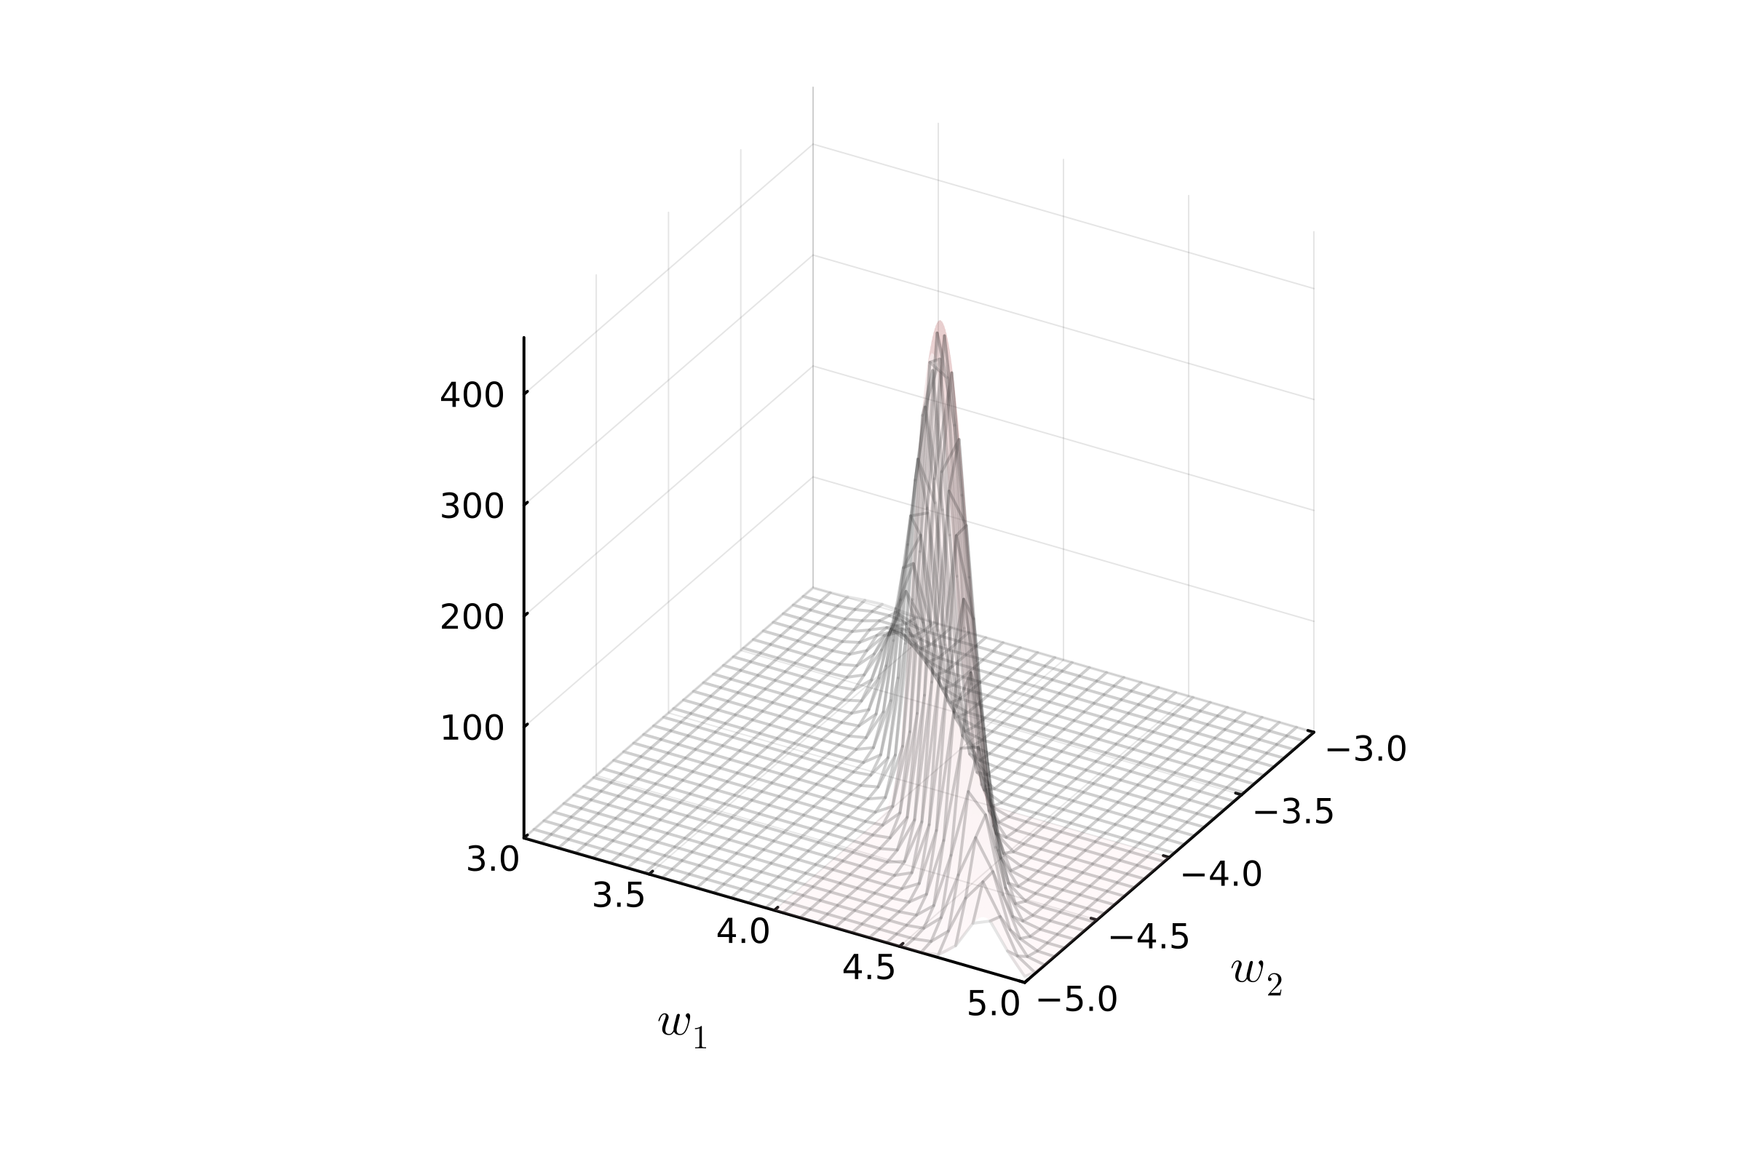
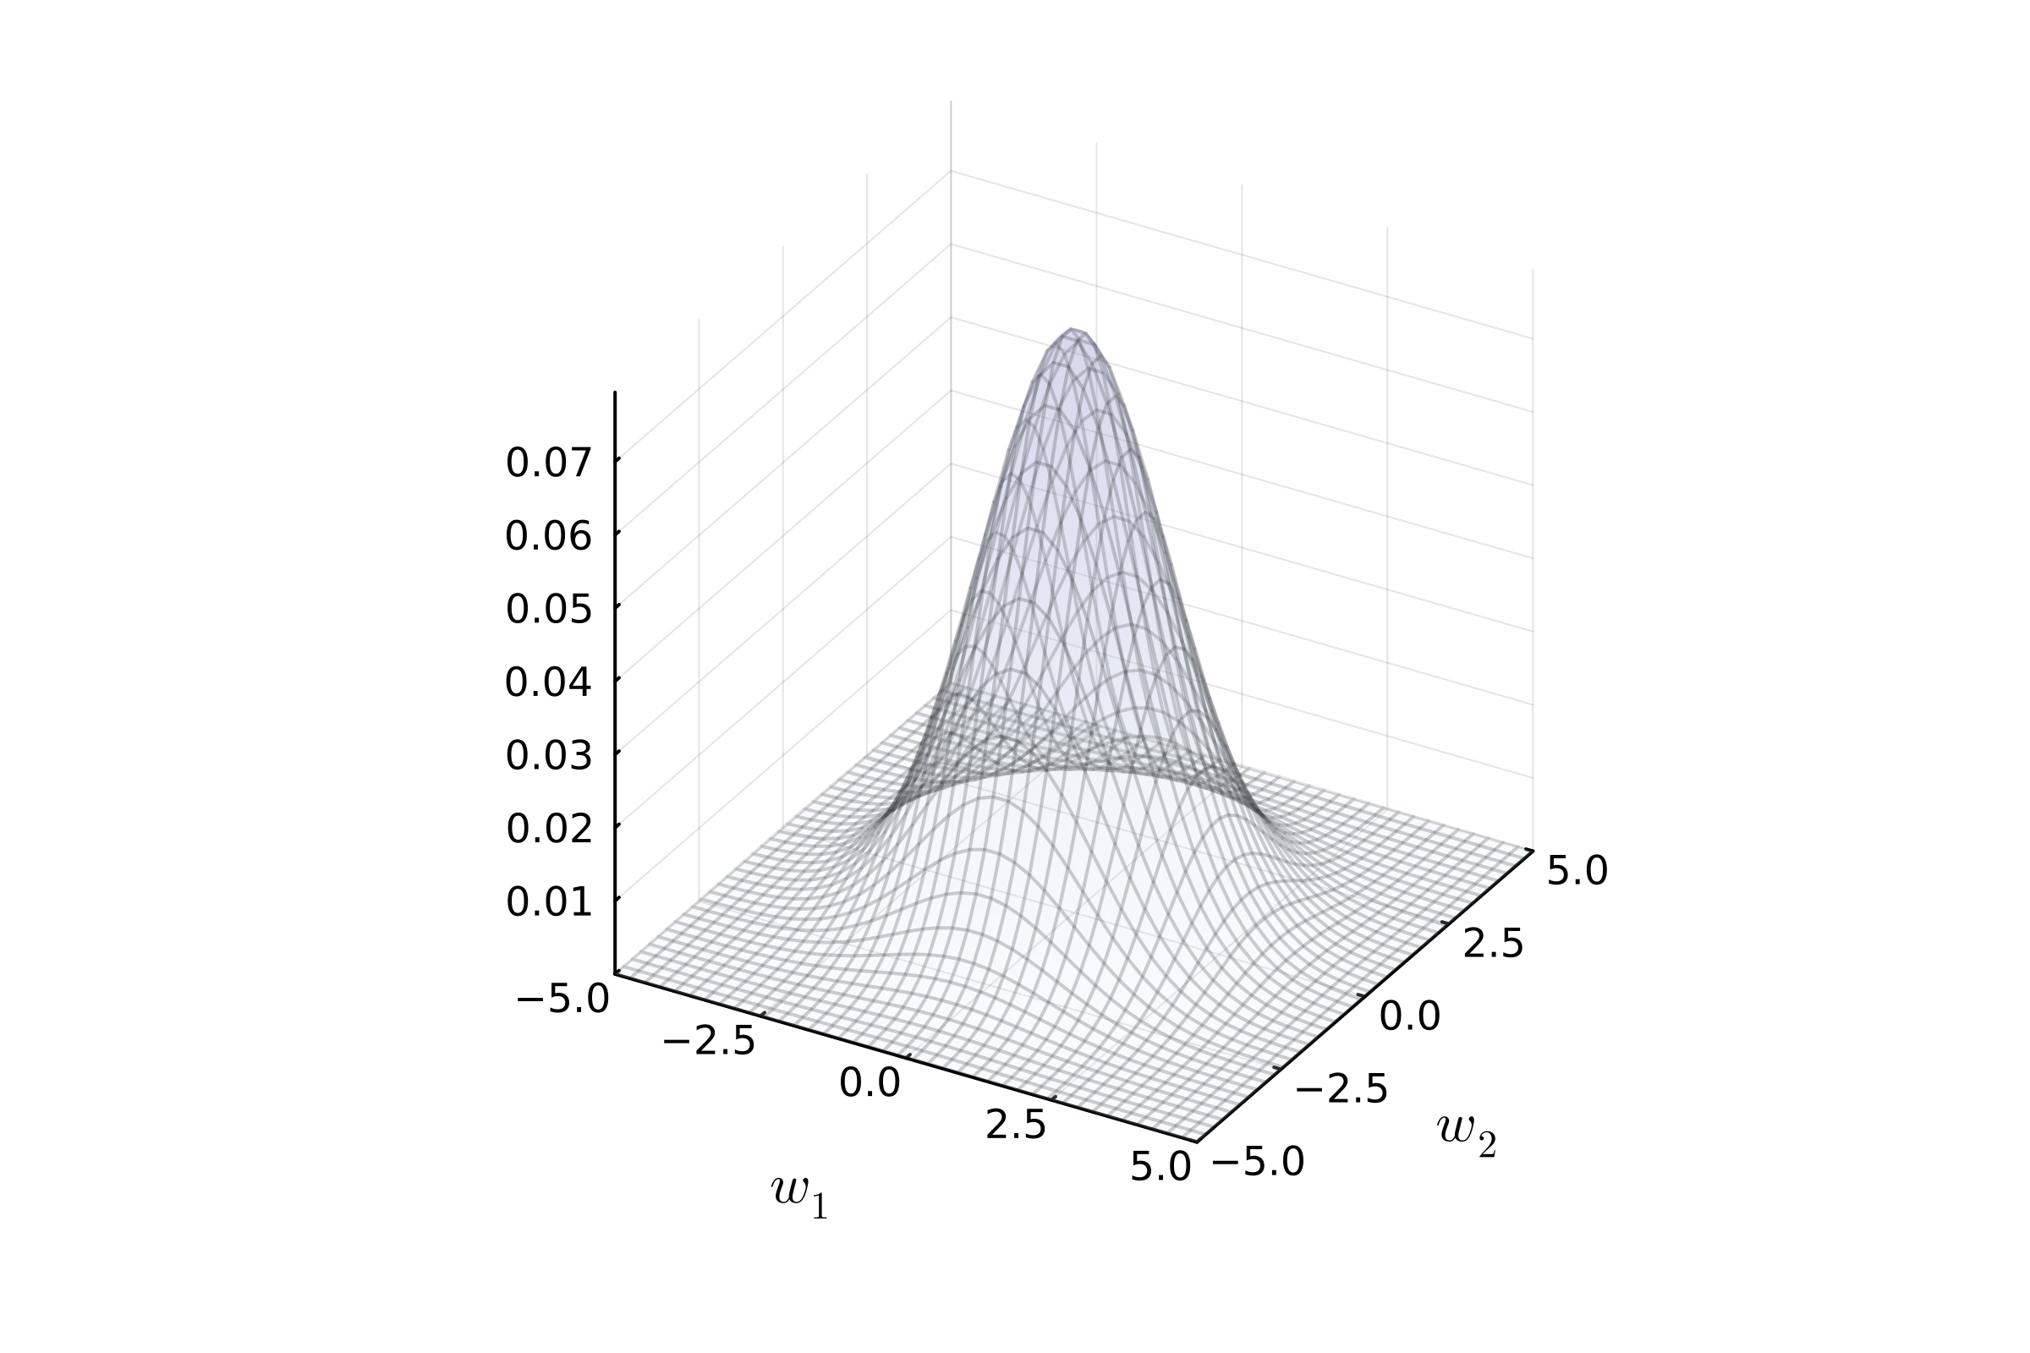
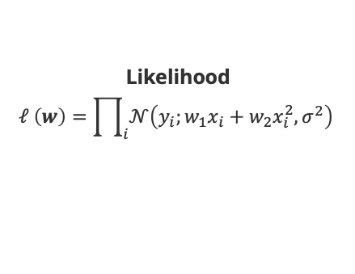



Probabilistic Machine Learning: Polynomial Regression
Likelihood
$$ℓ \left(w\right)=\prod_{i}{𝒩\left(y_{i};w_{1}x_{i}+w_{2}x_{i}^{2},σ^{2}\right)}$$
Training Data
$$D∈ℝ^{2}$$
Prior
$$w∼𝒩(w;0,I)$$
$$f\left(x;w\right)=w_{1}⋅x+w_{2}⋅x^{2}$$

Slide 21







Predictions and Predictive Distributions
$$P\left(y|x,f\right)$$
Predictive distribution using the sum rule of probability
$$p\left(y|x,D\right)=∫p\left(y|x,f\right)⋅p\left(f|D\right) df$$
But how do we get $p\left(f | D\right)$? Bayes’ rule!
$$p\left(f | D\right)=\frac{p\left(D|f\right)⋅p\left(f\right)}{p\left(D\right)}$$
$$P\left(f|D\right)$$
$$P\left(D|f\right)$$
$$P\left(f\right)$$

Slide 22


Probabilistic Machine Learning: Bayesian Inference
Two computational difficulties:
Posterior $p\left(f | D\right)$ requires the multiplication of likelihood with prior which often results in a distribution which is no longer in a family with very few parameters
Exception: If the likelihood and prior are conjugate and in the exponential family, then posterior computation is just a small number of parameter updates (additions!)
Predictive distribution $p\left(f | D\right)$ requires the summation of the data distribution over all prediction functions. This is only feasible for a small number of parametric distributions
Likelihood $p(x|θ)$ | Model Parameter | Conjugate Prior $p(θ)$
$$Ber\left(x;π\right)$$ | $$π$$ | $$Beta\left(π;α,β\right)$$
$$Bin\left(x;n,π\right)$$ | $$π$$ | $$Beta\left(π;α,β\right)$$
$$𝒩\left(x;μ,σ^{2}\right)$$ | $$μ,σ^{2}$$ | $$𝒩\left(μ;m,s^{2}\right)$$

Slide 23
Overview
Information Theory
Arithmetic Coding
Distance Measures for Probabilities
Inference Methods
Bayesian Inference
Maximum Likelihood Estimation
Decision Making

Slide 24


Maximum Likelihood/Maximum A-Posteriori Inference
Maximum Likelihood. Find the most likely function $f_{ML}\left(D\right)$ given the data $D$ and approximate $p\left(f | D\right)$ by a single point distribution around
$$f_{ML}\left(D\right)=\max_{f}{p\left(D | f\right)}$$
Maximum A Posterior. Find the most probable function $f_{MAP}\left(D\right)$ given the data $D$ and prior approximate $p\left(f | D\right)$ by a single point distribution around
$$f_{MAP}\left(D\right)=\max_{f}{p\left(D | f\right)⋅p\left(f\right)}$$
Pros:
Learning = optimization in the hypothesis space (“gradient descent”)
Storing the model = storing the function parameters
Cons:
The posterior/likelihood is “peaked” around a single best predictor (convergence)
No model uncertainty after learning from data
Sir Ronald Fisher (1890 – 1962)

Slide 25


Maximum A-Posteriori Inference: Polynomial Regression
$$f\left(x\right)=w_{1}x+w_{2}x^{2}$$
$f\left(x\right)=w_{0}+w_{1}x+w_{2}x^{2}+w_{3}x^{3}$ $+w_{4}x^{4}+w_{5}x^{5}$ $+w_{6}x^{6}$
$$f\left(x\right)=\sum_{i=0}^{10}{w_{i}⋅x^{i}}$$

Slide 26

Relation to Deep Learning
Deep Learning is maximum likelihood inference on a layered function model
Neural Networks: $f\left(x\right)=h\left(W_{L}⋯h\left(W_{2}h\left(W_{1}x\right)\right)\right)$ where $h$ is a sigmoid
Number of layers: $L$
Each element of each vector is called a “neuron”
Each product of the inner products is called a “synapse”
Maximum Likelihood optimization via gradient descent (w.r.t. $W_{1},W_{2},…,W_{L}$)
Application of the chain rule of differentiation = back propagation
Predicting and gradient computations are matrix multiplications; today, they are sped up using GPUs (which parallelize matrix multiplication)
Regularization for the Deep Learning algorithms are equivalent to prior assumptions on $p\left(W_{1},W_{2},…,W_{L}\right)$!

Slide 27
Overview
Information Theory
Arithmetic Coding
Distance Measures for Probabilities
Inference Methods
Bayesian Inference
Maximum Likelihood Estimation
Decision Making

Slide 28

Loss Functions
Decision Theory: Decision theory is concerned with the theory of making decisions based on uncertain outcomes and assigning numerical consequences to the outcome.
Answers the second key question of machine learning: What prediction $\hat{y}$ shall be made for an example $x$ having seen $D$?
Requires knowledge of the numerical consequence of taking an action (loss or utility function)
Loss Function: A loss function $l:𝒴×𝒜→ℝ$ is a function mapping the outcome space $𝒴$ and an action space $𝒜$ to a real number representing the "cost" associated with taking the action $a∈𝒜$ when the true state of the world is $y∈𝒴$.
Losses are given by the domain problem; there are no “true” losses!
Example:
Giving a treatment after a cancer treatment (economic costs?!)
Deciding which advertisement to show on a search result page (bids!)
 |  | Actions
 |  | treat | nothing
Outcomes | Cancer | 0 | 1000
 | No cancer | 1 | 0

Slide 29

Optimal Decisions
Expected Loss Minimization. Given a predictive model $p\left(y | x\right)$ and a loss function $l:𝒴×𝒜→ℝ$, the optimal action $a\left(x\right)$ is determined by minimizing the expected loss
$$a\left(x\right)≔{argmin}_{a∈𝒜} E_{y∼p\left(y|x\right)}\left[l\left(y,a\right)\right]$$
Optimal decisions require (yet again) solving an optimization problem!
Example: If $𝒴=𝒜=ℝ$ and $l\left(y,a\right)={\left(y−a\right)}^{2}$ then $a\left(x\right)=E_{y∼p\left(y|x\right)}\left[y\right]$
Proof: Taking the first derivative and setting it to zero gives
$$\frac{d}{da}E_{y∼p\left(y|x\right)}\left[l\left(y,a\right)\right]=\sum_{y}{p\left(y|x\right)}⋅\frac{d}{da}{\left(y−a\right)}^{2}$$
$$=\sum_{y}{p\left(y|x\right)}⋅\left(2\left(a−y\right)\right)$$
$$=2⋅\left(\sum_{y}{p\left(y|x\right)}⋅a−\sum_{y}{p\left(y|x\right)}⋅y\right)$$
$$=2⋅\left(a−E_{y∼p\left(y|x\right)}\left[y\right]\right)$$ Reinforcement Learning is optimizing the expected loss over an (infinite) sequence of predictions, not just for one prediction!

Slide 30
Example: Binary Classification
Reject at 75% confidence
Decide for 0
Decide for 1

Slide 31

Summary
Information Theory
Information theory measures the amount of uncertainty and only depends on probabilities.
The information of each outcome of a probability distribution is $\log_{2}\left(p\left(x\right)\right)$ bits and entropy is the expected information across all outcomes.
Entropy is the smallest size a file can be compressed to without loss (coding theory!)
Inference Methods
Inference is the task of inferring what we know about the plausibility of a prediction function in light of training data
Bayesian Inference is the only consistent inference technique requiring huge summations, but it is (usually) computationally too hard
Maximum Likelihood Estimation is often easier and reduces machine learning to parameter optimization – but we are losing model uncertainty
Decision Making
In order to make automatic decisions, we require domain-specific loss functions
Decision making requires optimization (again!)

Slide 32
See you next week!

